Slide 1
CCMS
BLACK CODE
Mrinal Tyagi
Dinesh Bhagat
Dipanshu Verma
Abhijeet Manhas

Slide 2
Technologies used :
Django
Google maps api
Sckit-learn
Gmplot
OPTICAL SENSORS
IOT

Slide 3
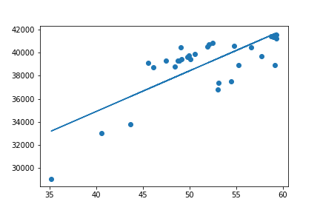
Data analysis
time
.
Power usage

Slide 4
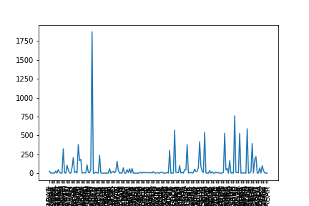
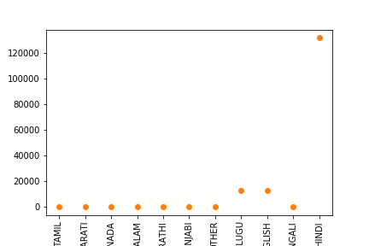
.
complaints
.
complaints
cities

Slide 5
How it works
We use the raw data and complaint’s data to make a heat map.
This heat map points to the ccms that has faulty lights.
Optical sensors connected to IOT device in that area are used to PIN-POINT the faulty light.

Slide 6
OPTICAL SENSOR( IOT )
The sensors collect amount of light from the lights and we record their intensity when they are all working.
Comparison is made.
We get the exact default light.
Data is sent to regional center via broadband in real time.

Slide 7
Why not IMAGE PROCESSING ?
Cost – cameras cost beyond 5k while optical sensors cost bw 200 -300 .
We can’t put Cameras at every 100 m.
Optical sensors can do extra tasks as well.
To make SMART CITY we need a network of Optical sensors based IOT devices as per IOT experts .

Slide 8
Derived BUSINESS from this MODEL
Based on Database
Database sharing with Infra. Developers leading to endless possibilities.
Co-operation with TMS.
Targetted ads.

